Slide 1


Technology
in good company

Slide 2
twoday is a leading solutions partner for large companies and the public sector.
We offer expertise and a wide selection of solutions to help big organisations succeed in their
digital transformation.

Slide 3






We create a better
tomorrow through technology
2 600
25%
Employees
in 31 offices
Average revenue growth
2015-2022
700
500
460
300
326 M€
8 000
Revenue 2022
Customers
50% Private / 50% Public
950
150

Slide 4

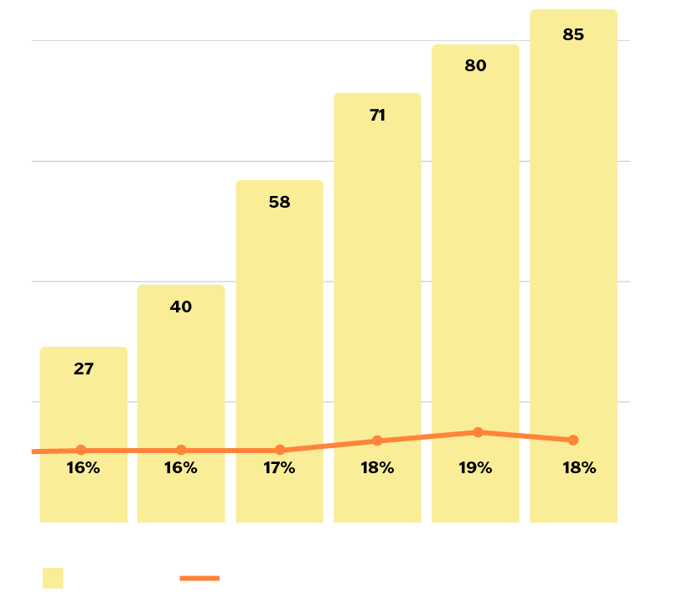


Finland
700+
500+
Employees
Customers
Offices in Helsinki, Tampere, Turku, Oulu, Lappeenranta, Jyväskylä, Espoo, Hyvinkää
60% Private / 40% Public
5
63/60
Companies
twoday Oy, twoday AI Works Oy,
twoday Business applications Oy,
twoday Biit Oy, BeanBakers Oy
NPS / eNPS

Slide 5

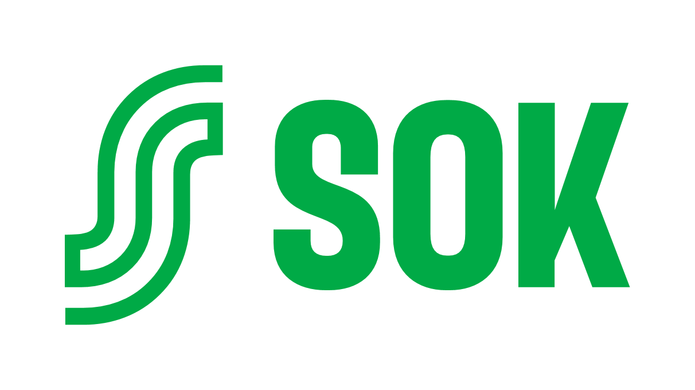


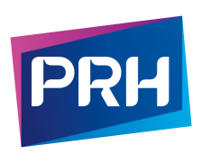


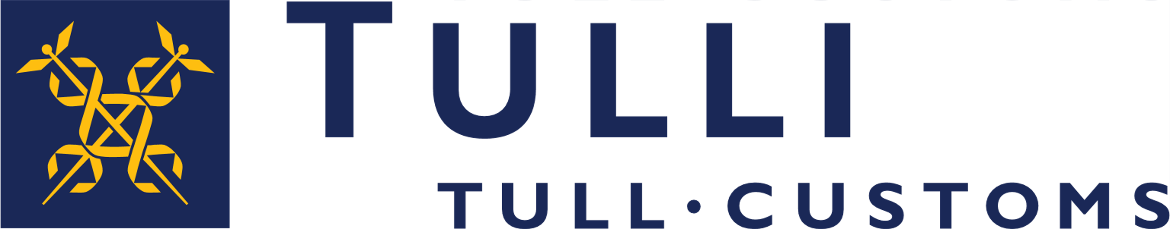
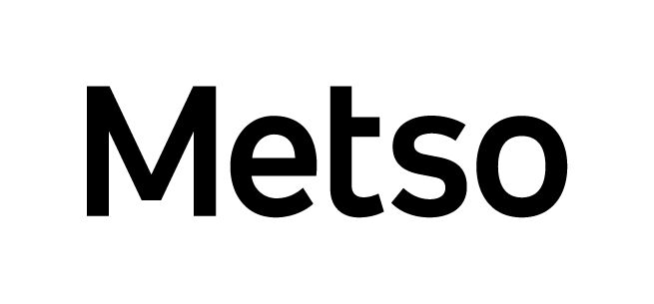

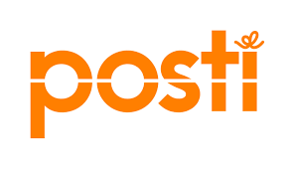

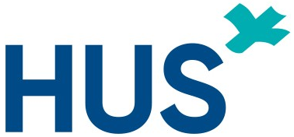
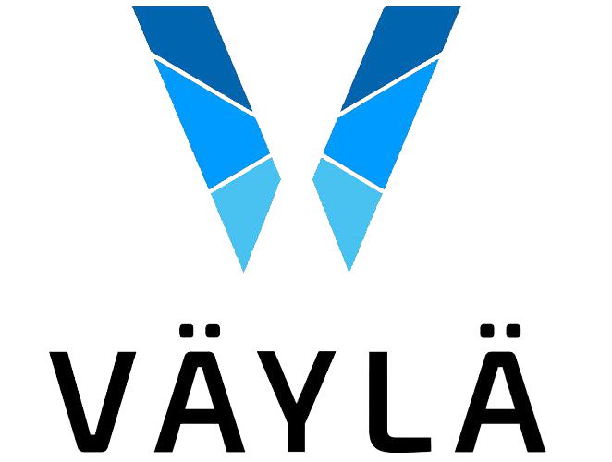
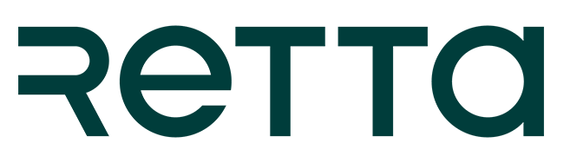










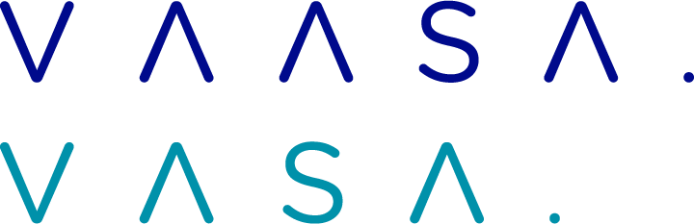










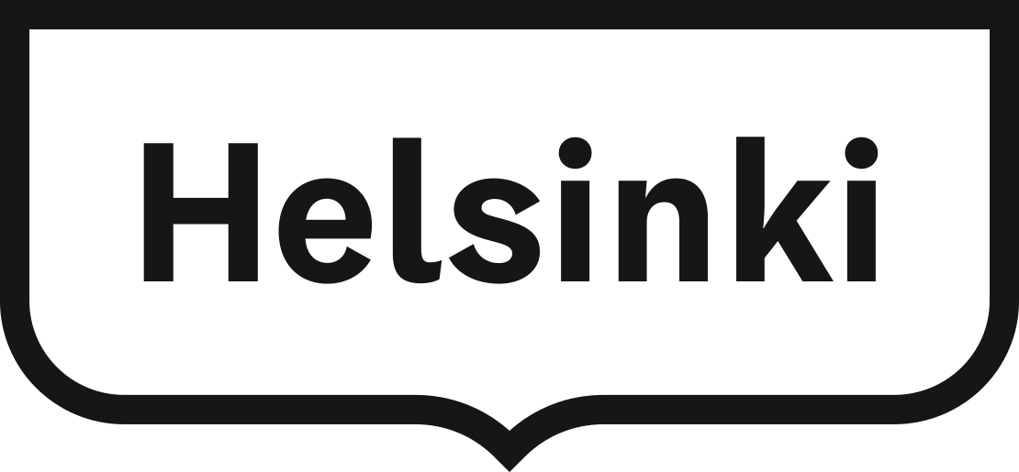



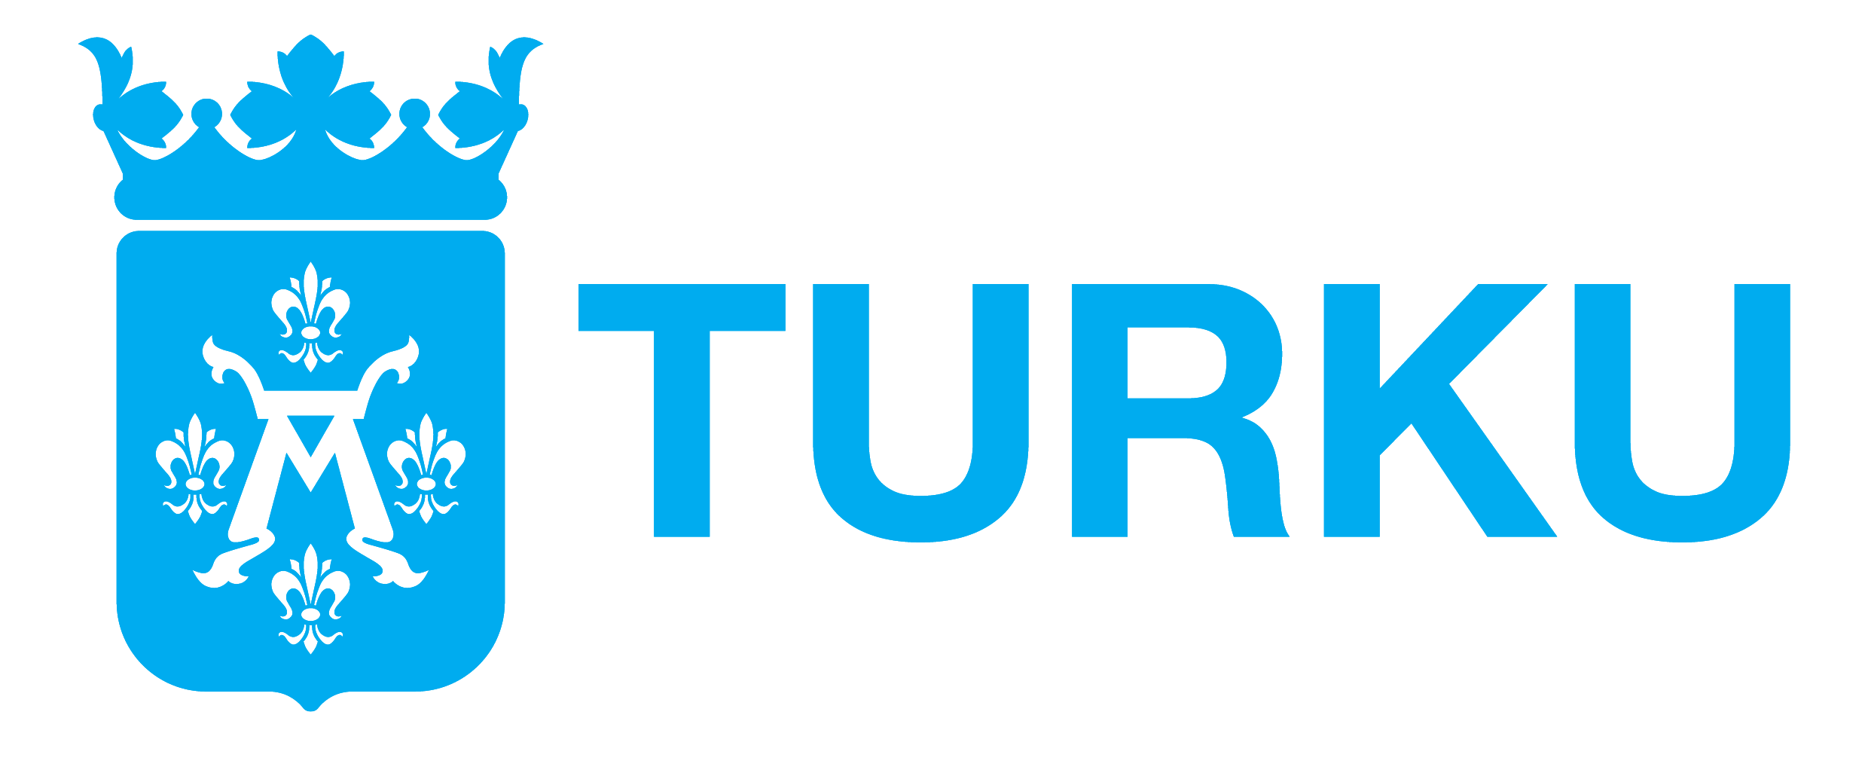
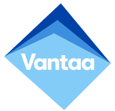
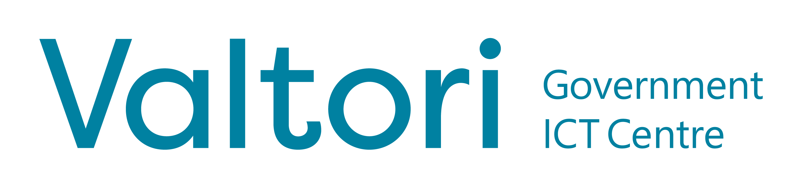


A few of our customers
Private sector
Public sector

Slide 6
What can we help you with?

Slide 7
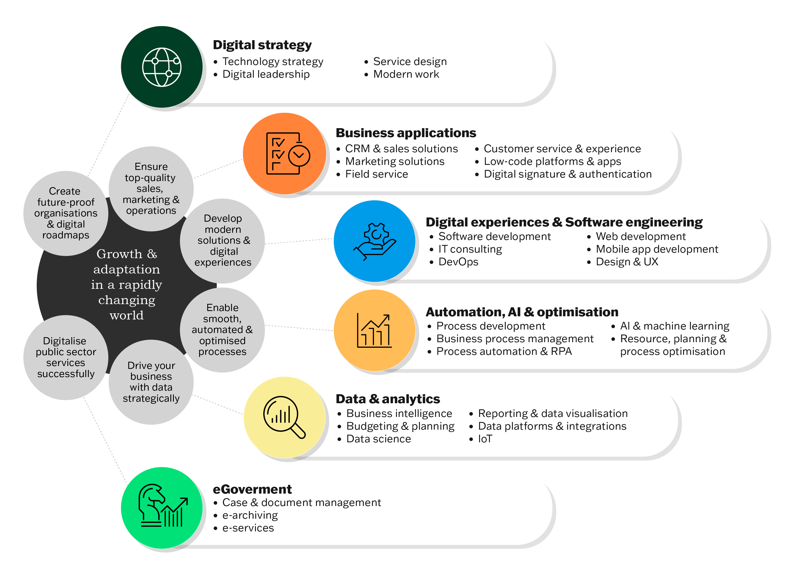
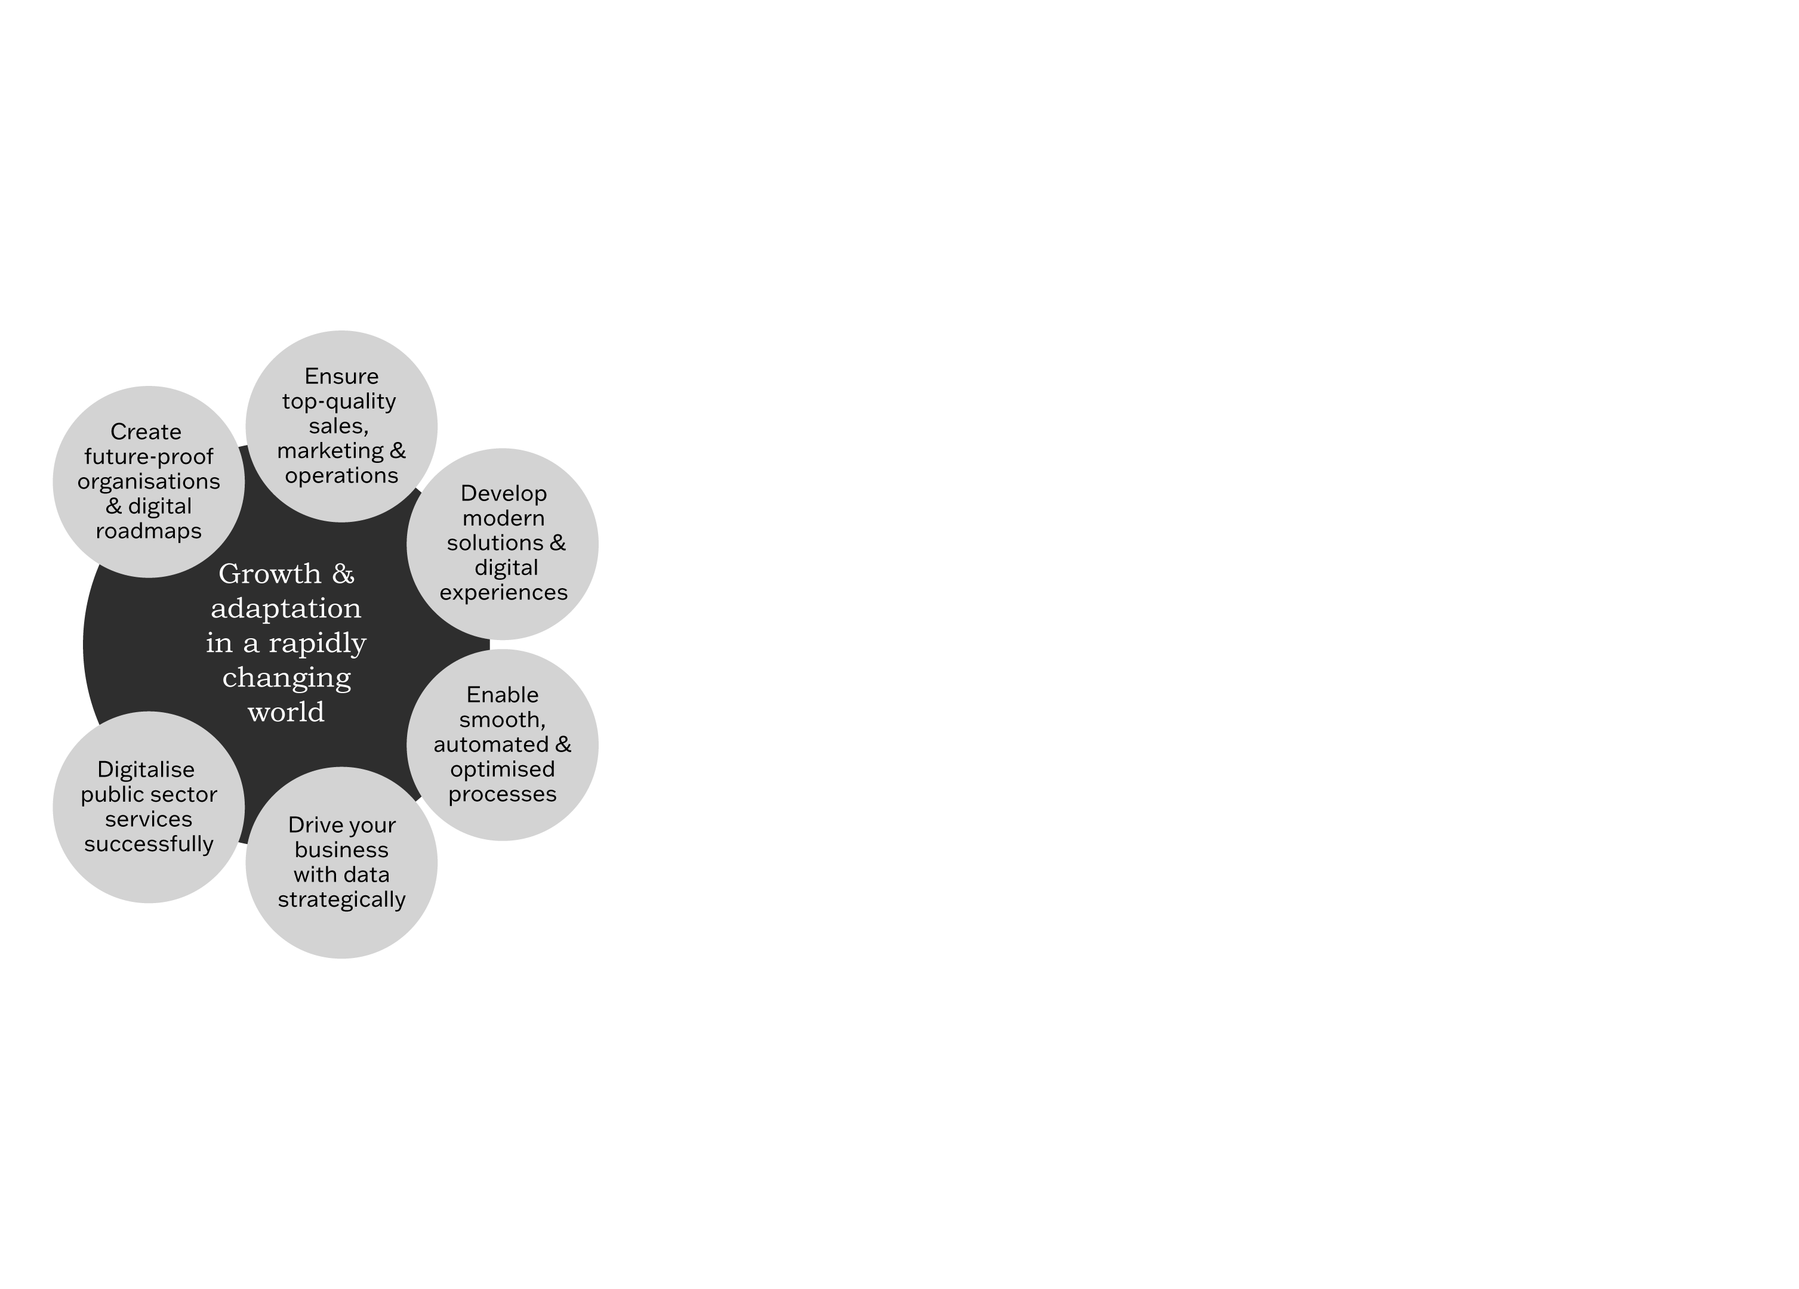
Our services
Notes:
Me ollaan ratkasutalo tarjotaan laajaa osaamista jossa me tiedetään että on tarpeita.
Meidän tavoita on olla näkemyksellinen kumppani
Digistrategia -> kokonaiskuva roadmap tulevaisuuteen
Business applications -> kolmannen osapuolen järjestelmät jolla voidaan kehittää prosesseja
Räätälitekeminen -> jossa tehdään räätälöityjä järjestelmiä kun ei löydy valmista
Automaatio, AI ja optimointi -> data-alusta ja platta, analytiika optomointi ja tekoäly/koneoppimisen
Kunnilla inka paljon py

Slide 8


Digital strategy
Create future-proof organisations & digital roadmaps

Slide 9
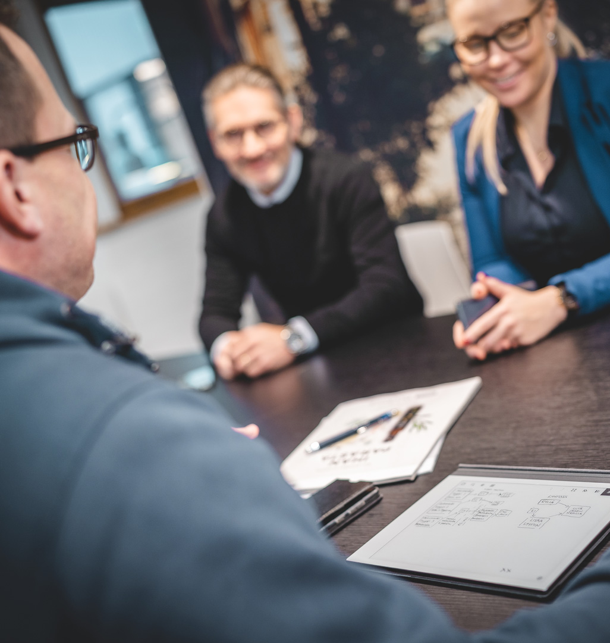

How we can help
We help our customers define their digitalisation roadmap to optimise their organisation’s performance. This includes defining the services, processes, technologies and the transformation programs that shape their digitalisation journey.
Organisations are struggling with finding the correct direction with constantly changing customer needs, market and technology development. Renewing the ways of working requires a thorough analysis of the current situation and redefining how things should be done in a digital environment.
Our competencies
  Technology strategy
  Digital leadership
  Service design
  Modern work

Slide 10


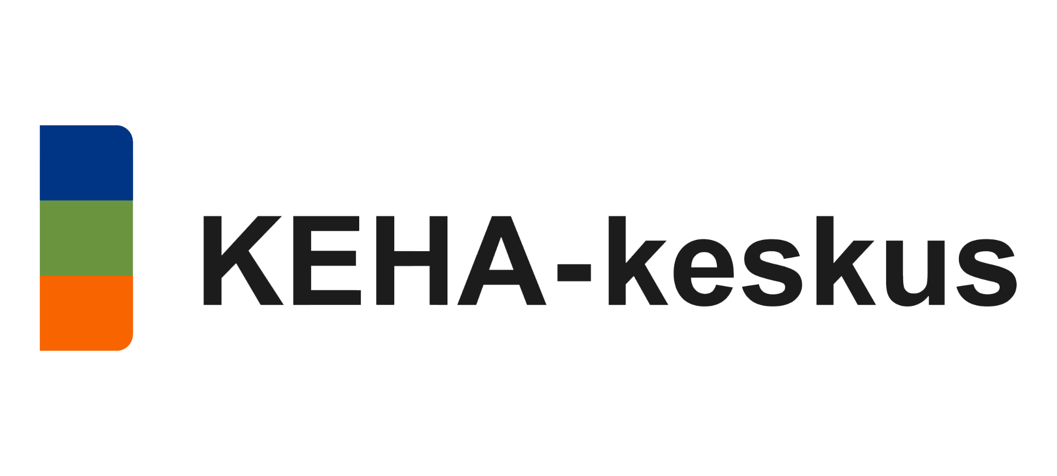

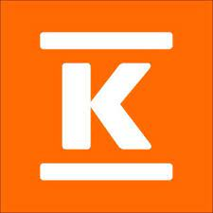

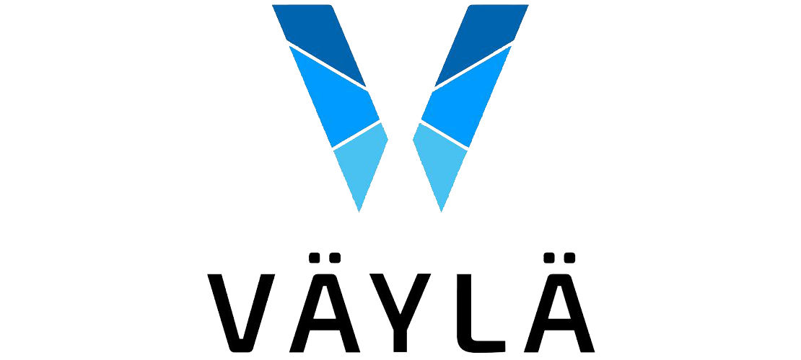
Some of our customers
We have implemented hundreds of projects for Finnish enterprises and public sector organisations in the area of service design, process design and digitalisation roadmaps.

Slide 11
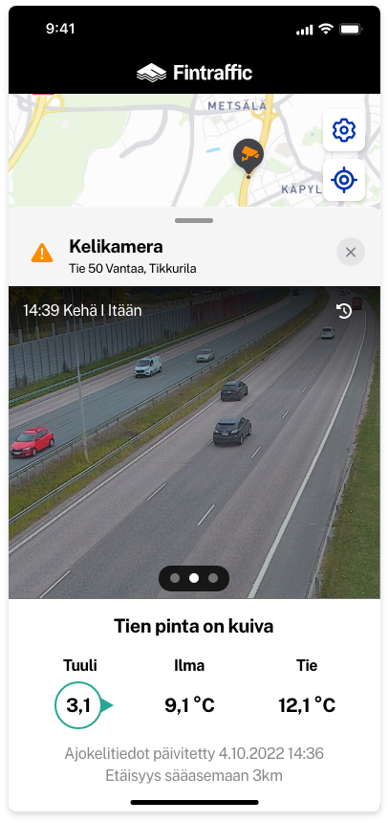
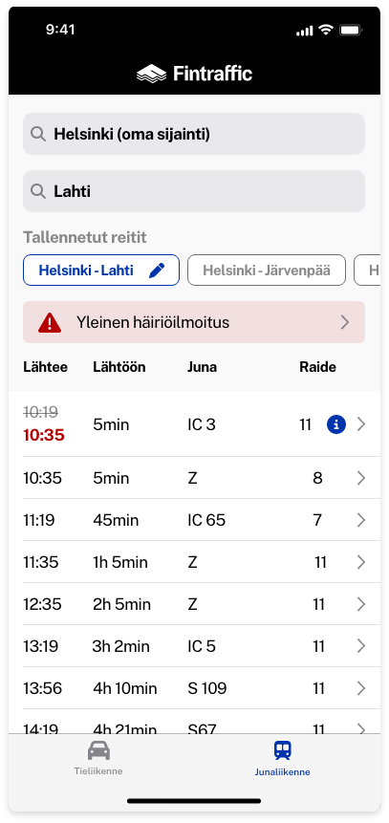
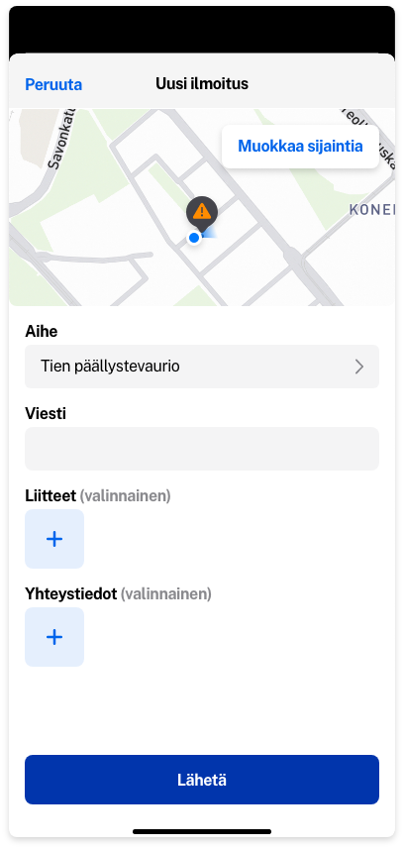

Customer success stories:
Fintraffic – mobile app
We designed a web and mobile application for Fintraffic for planning national transportation in road, sea, train and air transportation. Applications give an online status of traffic as well provide a tool to plan your journeys for all citizens in Finland.
Our team covered the following areas:
Workshops, observing and interviews to define the needs and concept of the solution
Designing the applications including usage
and user interfaces
Usability testing

Slide 12
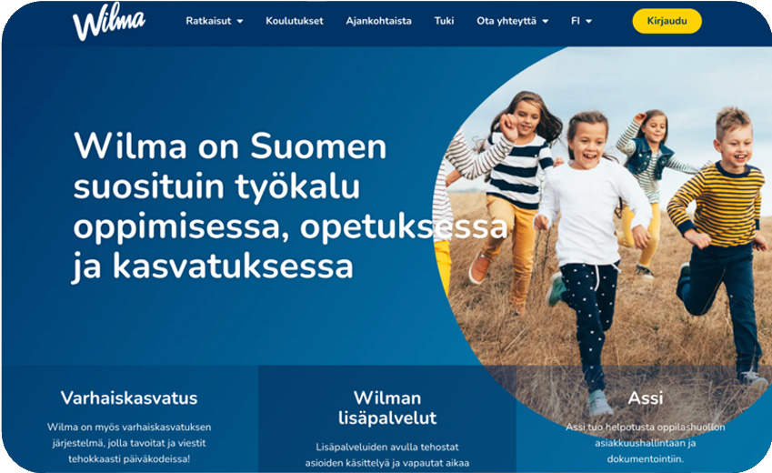
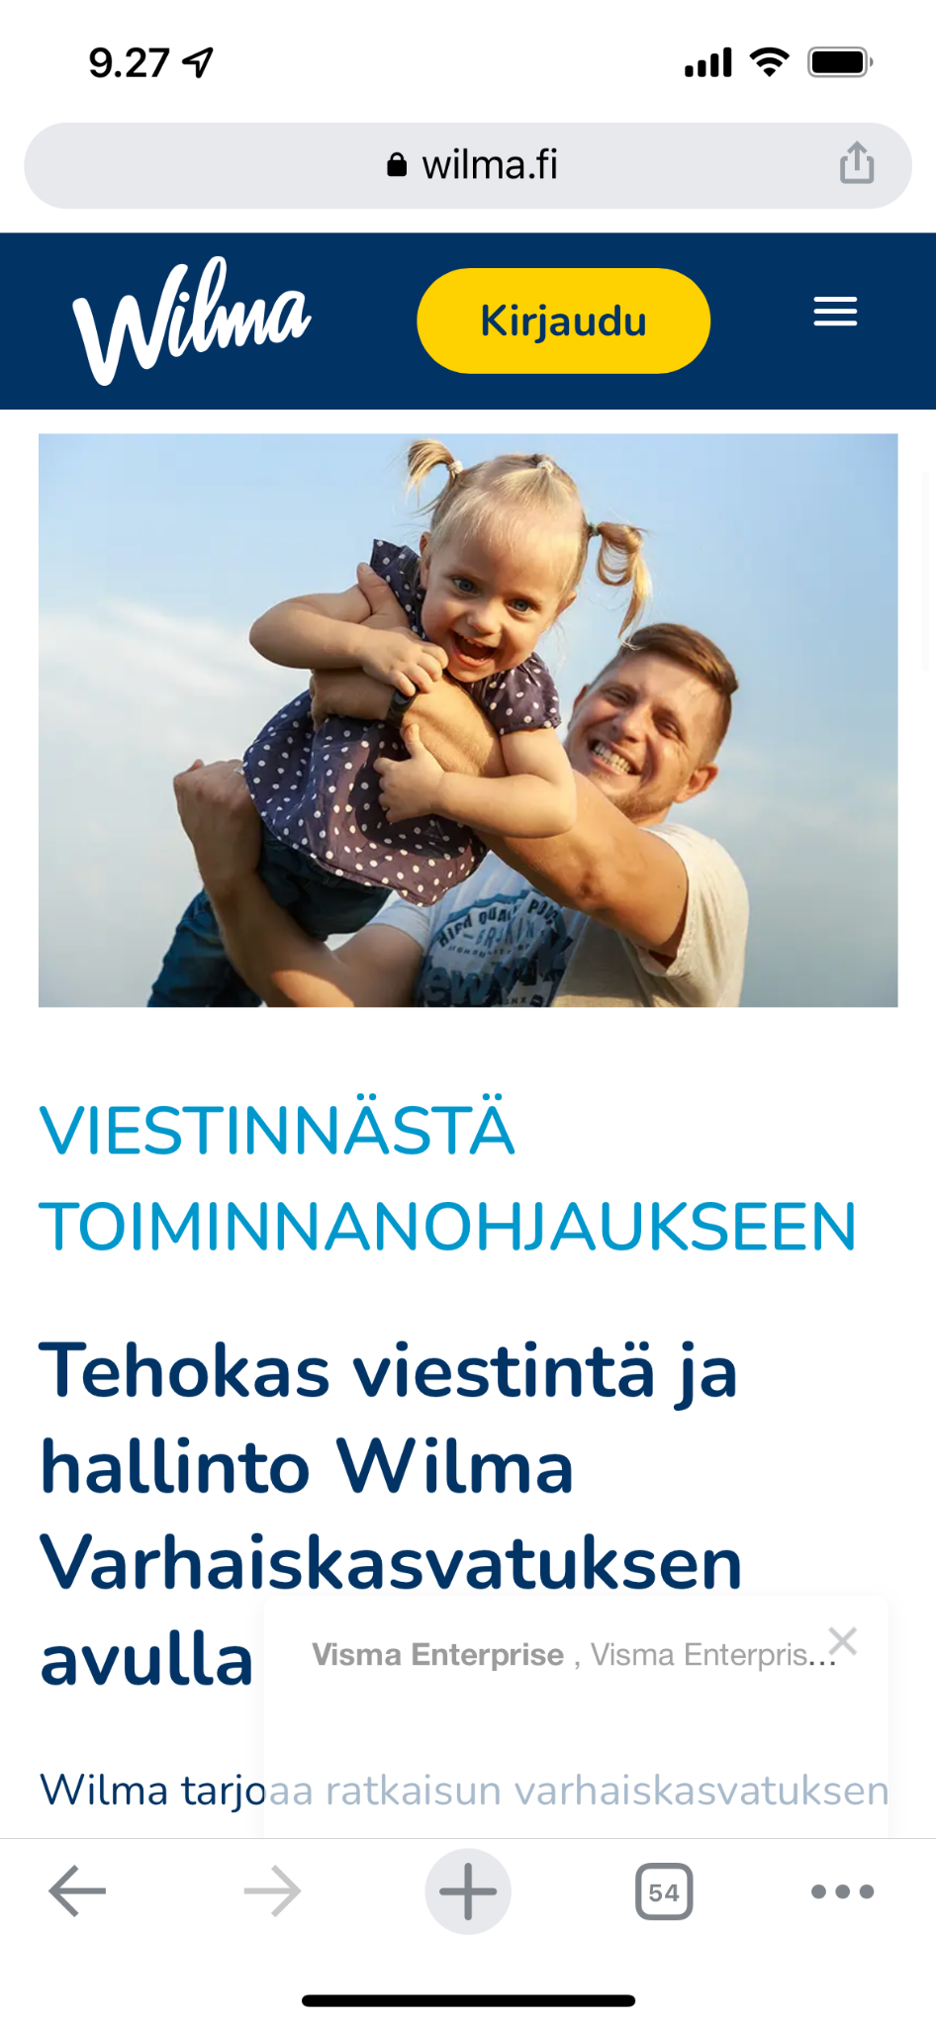

Customer success stories:
Wilma re-design
We implemented a full brand re-design for Wilma education software which is used by over 2 million Finnish schoolchildren and parents.
Scope of the project:
Brand re-design
Service design of the application
Design and implementation of the web site
Design of the new mobile app for Android and iOS

Slide 13


Business applications
Ensure top-quality sales, marketing, service processes
& customer journeys

Slide 14

How we can help
We accelerate sales, drive services, and improve customer experience with the leading cloud business application solutions.
Our approach is based on analysing the business and end-user needs, and then defining the right solutions and technologies for you.
Challenges in typical organisations:
No shared visibility between functions into up-to-date customer data
Existing legacy apps are focused on laborious data entry, slowing down daily work
Fragmented business applications with poor integrations and inconsistent UX
Bad customer experience, and different channels are not synchronised
We transform
  Sales and CRM
  Marketing
  Customer service & experience
  Self-service portals
  Field service
  ESM/ITSM
  Digital Signature
  Business process management & development

Slide 15


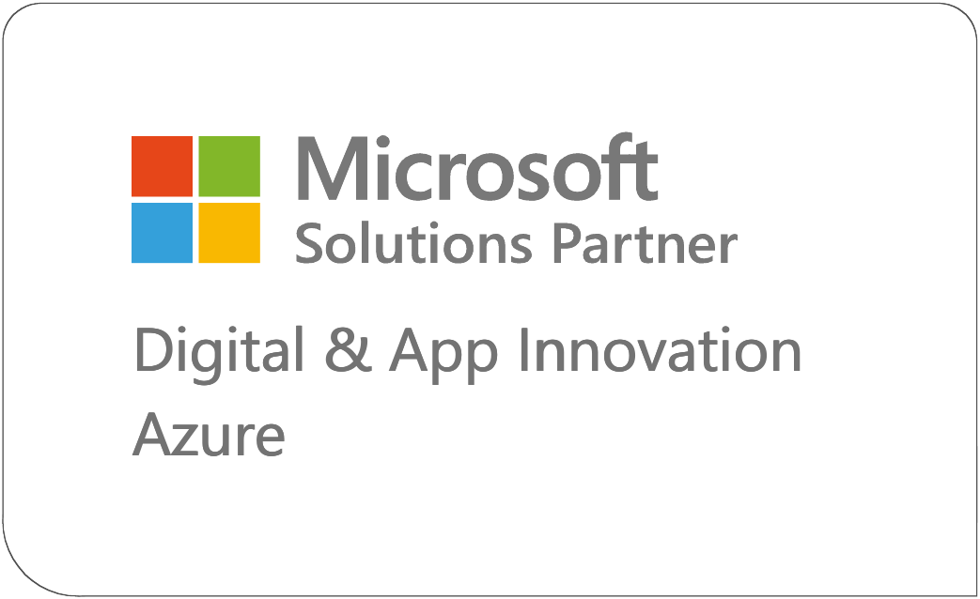









Microsoft cloud solutions
Business applications
We modernise and innovate business applications with Microsoft cloud.
Our approach is both business-driven and user-centered.
Our solutions build on Power Platform and Dynamics 365, but also:
    Leverage Azure for integrations and as a data platform.
    Utilise Microsoft 365 for collaboration and productivity.
We are a leading Microsoft Solutions Partner for Business Applications.
Sales & CRM
Marketing
Customer Service
Field Service
Supplier data management
Contract management
Modern work
Integration and automation

Slide 16

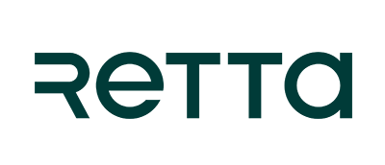


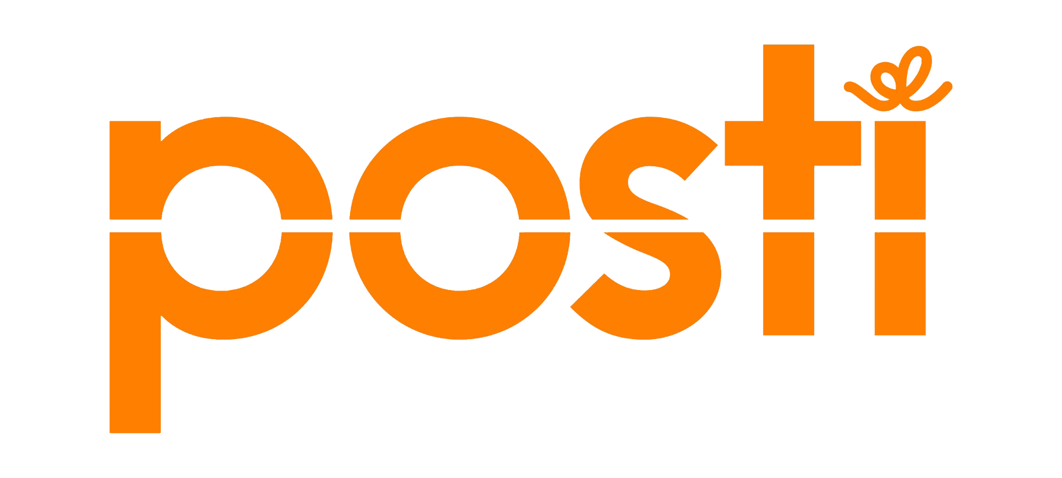
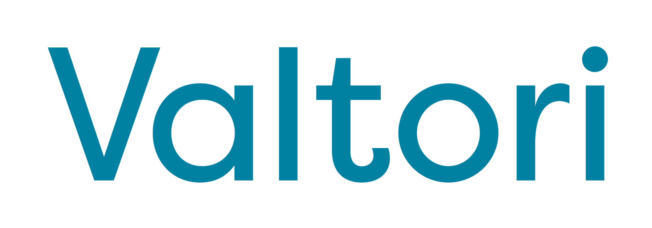
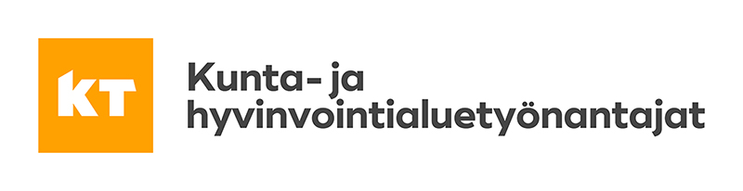
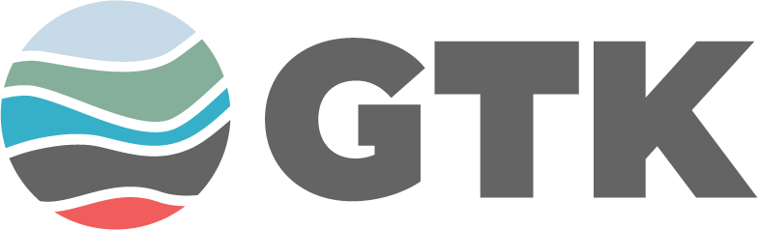
Some of our customers
Our customers include many leading enterprises of their respective industries as well as large government organisations. We support our customers as a partner, in their multi-year strategic transformations.

Slide 17
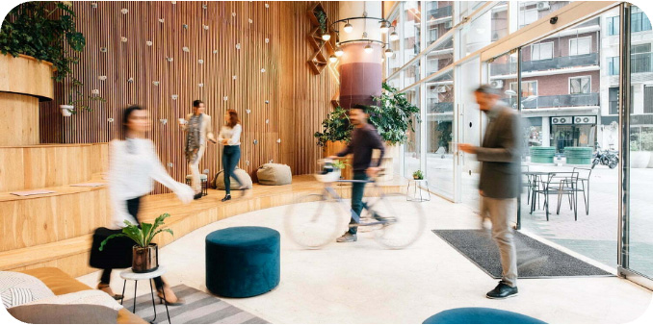

Customer success stories:
Retta Group
Retta, the largest provider of brokerage and management services of apartments and commercial facilities in the Nordics, initiated a strategic change management program in 2019 to respond to major drivers affecting its industry.
During our partnership, Retta has gradually modernised and innovated critical end-to-end business processes for its retail management, commercial estate, and house rental businesses with Dynamics 365 and MS cloud.
Key deliveries include:
End-to-end retail services management process support for ~ 1000 retail estate agents
New operating model for commercial properties management
Group-level supplier data management solution
House rental ecommerce back-end
“Our real estate management modernisation project is an excellent example of agility and speed that modern Microsoft cloud enables in developing new ways of working. twoday provides us with comprehensive partnership and agile development team that we can rely on implementing our business transformation roadmap”
Harri Karjalainen,
CIO, Retta

Slide 18
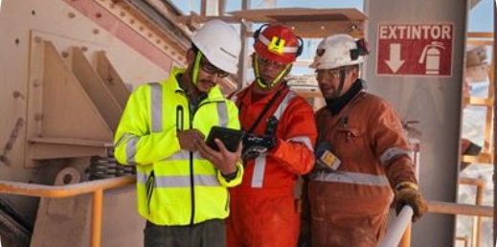
Customer success stories:
Metso
With 16 000 employees in 50 countries, Metso is a frontrunner in sustainable technologies, end-to-end solutions and services for the aggregates, minerals processing and metals refining globally.
As a part of a multi-year strategic program, twoday
has supported Metso in transforming to a customer focused services company.
We’ve modernised tens of business applications that impact the workday of thousands of end-users, including:
Global field service management system
Project management platform
Services business processes
Supplier data management (ex. Outotec)
Sales CRM (ex. Outotec)
“The Field Service digital platform is already widely implemented, and we have received very positive feedback from our customers and technicians.”
Source: metso.com
Martin Karlsson,
Senior Vice President, Professional Services,
Metso

Slide 19






Salesforce solutions
Business applications
Business Development
Agile & Continuous Development
Data Driven leadership & consulting
Service Design
Change Management
Digitalization journeys
We help ambitious organisations grow by enabling superior customer journeys. We talk business and excel in Salesforce technologies.
We help our customers throughout their development cycle from customer journey planning to end user training.
(Key) Account Management
B2B/B2C Commerce
Channel Sales Management & Leadership
Data Driven Growth Leadership
Configure, price Quote
Customer activation & Sales
On-boarding & Customer services
Customer Service solutions
Field Service
Automated on-boarding journeys
Process management & automation
Feedback Management
Customer
360
Marketing & raising awareness
Lifecycle & Digital Services
Data & Activation
Marketing Automation
Lead Generation
Nurturing programs
Marketing Communication
Transactional marketing & communication
Account based marketing
Asset Lifecycle management
Customer / Partner portals
Subscription management
PSA & Project management
Customer Data Platform
Engagement data & Activation
AI & Analytics
Business reporting
Master-data management
Integrations

Slide 20
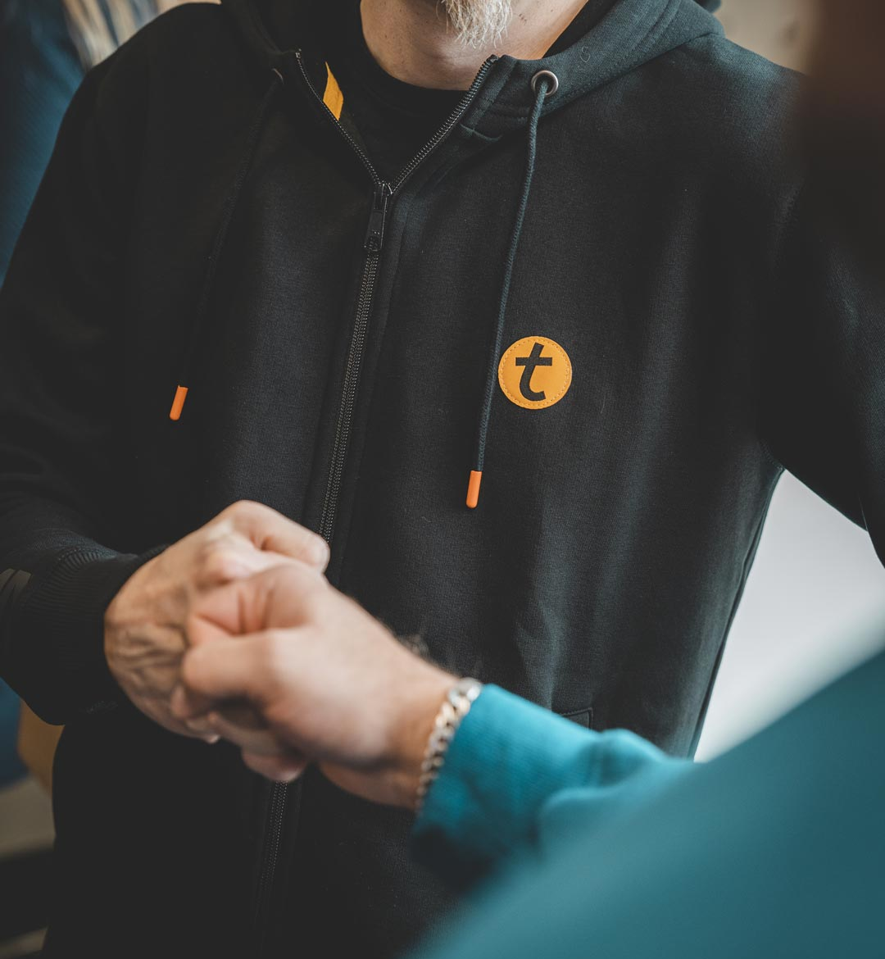
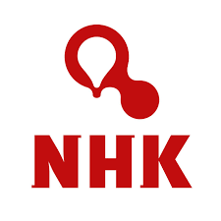
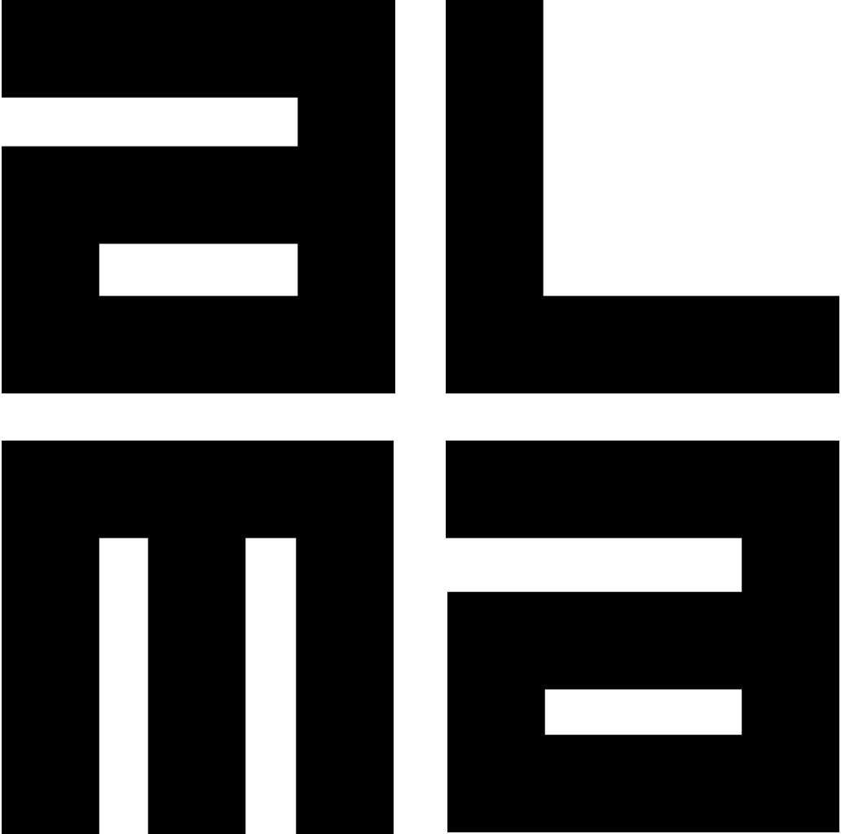


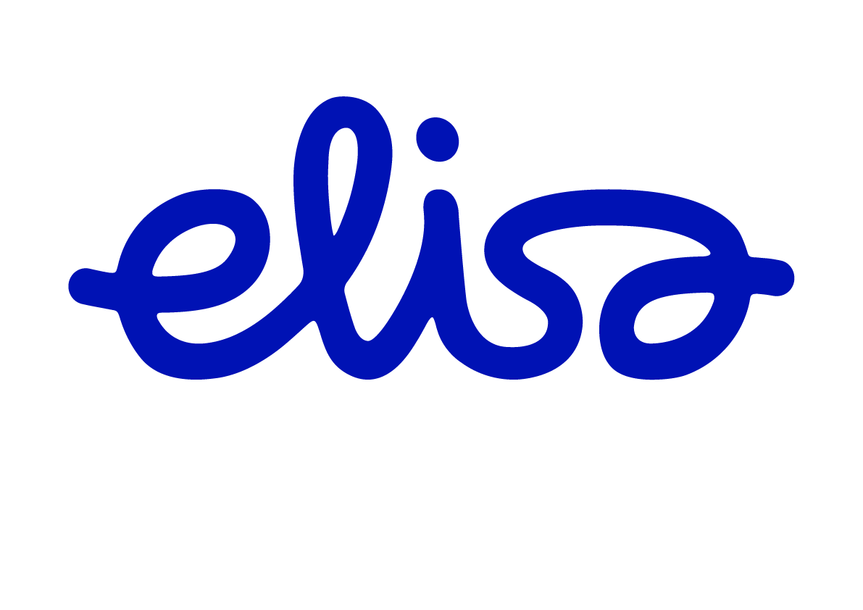

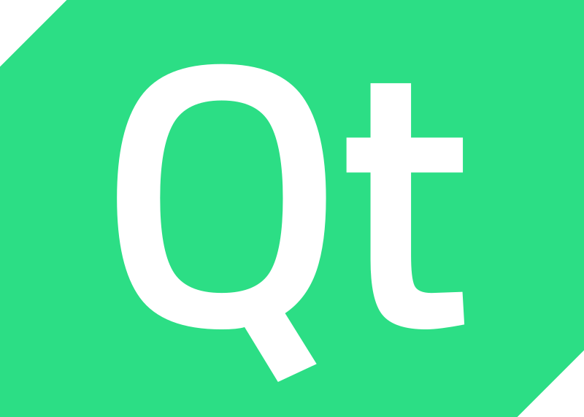

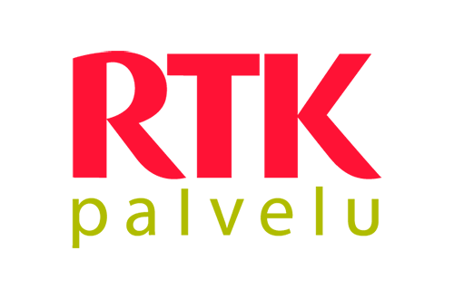
Some of our customers
Transforming Customer Journeys
We talk business and excel in Salesforce technologies. We help our customers in managing their business with Data Driven Leadership, and designing and implementing modern customer journeys.

Slide 21

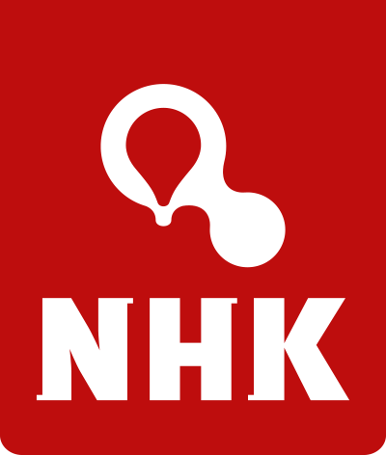
Customer success stories:
NHK
NHK-keskus specialises in helping their customers in making profitable agriculture. NHK is the provider of agricultural machinery and automated milking systems to their customers.
With NHK we created a true customer 360 view for the whole customer lifecycle, including the following business areas:
CRM and Sales management
Machinery sales configurator
Customer 360 and Account planning
Field Service
Spare parts sales configurator
“twoday Biit has been an excellent partner in helping us digitalise an old-fashioned industry and in providing our business with new capabilities.”
Viljami Väisänen, IT Manager, NHK-keskus Oy

Slide 22
Digital Signature: Signom & X-Sign
Business applications
Signom and X-Sign are customisable digital signature services that cater to various needs.
Signom, being customisable and scalable, is suitable for complex organisational structures and processes, providing automatic workflows and extensive integration opportunities, e.g. trade register checks and paywalls.
X-Sign, designed for the public sector, offers versatile identification and signature methods, as well as ready-made workflows for the public sector's special needs.
Customisability: Our services are tailored to meet the specific needs of our customers.
Security: X-Sign and Signom use strong identification methods and adhere to strict data security norms, including EIDAS regulations. This ensures absolute security and reliability of our customers' data.
Scalability: Our services are suitable for both small and large organisations. Signom can adapt to and grow with the customer's business, offering extensive integration opportunities even in the most complex organisational structures and signature processes.

Slide 23
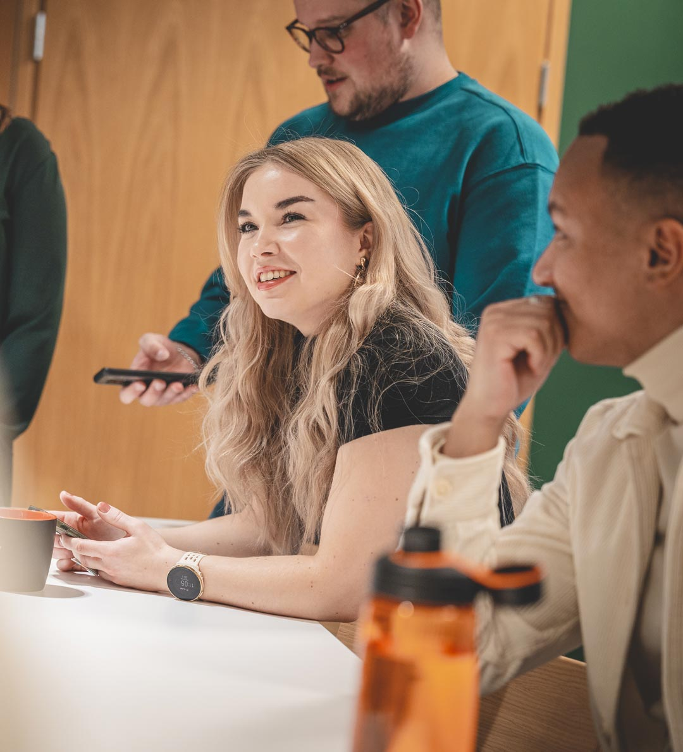


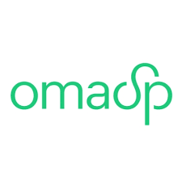





Some of our customers
Signom's customers include e.g. financial sector companies as well as trade and energy sector operators, as the solution is suitable for signing large and complex contracts and documents.
The X-Sign signature service is widely used by public administration actors, such as the largest cities, health and social care sector actors, and national signature services (e.g., ePrescription and the upcoming DVV's Stamp Service).

Slide 24


Customer success stories:
ST 1
Streamlined Corporate Card Applications
St1, receiving hundreds of mostly digital corporate card applications monthly, has automated and streamlined its process using Signom. This has eliminated unnecessary manual tasks, from identification and credit checks to automatic forwarding, account opening, and consolidated billing. Signom ensures no critical information is omitted and tailors automatic checks to the application and approval process.
“I’m super happy about our cooperation and twoday’s proactive approach."
Tia Rytkönen
Direct and Corporate Sales,
ST1

Slide 25


Customer success stories: Kiinteistömaailma
Digitalising the Real Estate Bidding Process
With Signom's integration into Kiinteistömaailma's system, the real estate bidding process has been fully digitalised without disrupting familiar processes. The system allows activation, completion, and electronic signing of property bids and counter-bids, user identification related to digital signing, and sending signature invitations and confirmations by email.
Additionally, Signom has enabled the customisation of forms to meet formal requirements of property bids, with mandatory fields and field-specific rules to guide users through the process.
“We’ve been able to trust Signom’s speedy delivery, technical functionality and twoday's ability to tailor solutions specifically for us.”
Mirka Mäkinen
tietojärjestelmien kehityspäällikkö

Slide 26

Customer service & automation
Business applications
We aim to create a smooth flow of interactions between businesses, employees, and customers, putting the focus on meaningful work and interactions.
Our Flow service is a comprehensive solution for businesses to streamline
their operations and improve customer experience.
Flow combines hyperautomation with a contact center platform
and voice-of-customer solutions.
WhatsApp Assistant module enables faster communication with
customers through a personal and reliable channel.
With our advanced AI and machine learning capabilities, we help businesses automate their processes, save time and money and provide exceptional service to their customers.

Slide 27


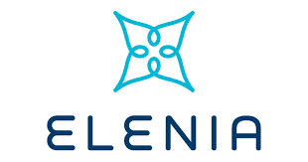




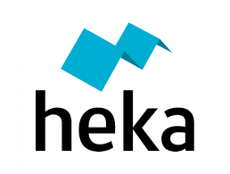




Some of our customers
We have been working since 2003 for excellent customer service experience by creating digitalised and automated workflows and processes.
Our customers are typically big and medium sized companies from various industries.

Slide 28
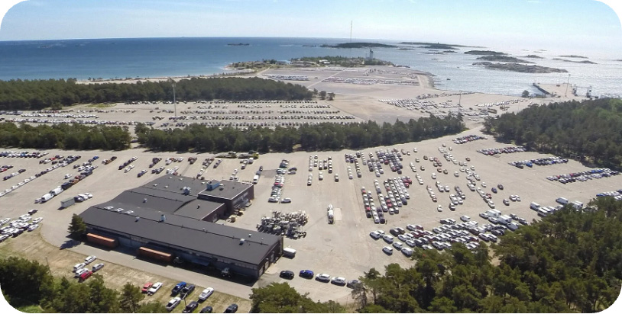

Customer success stories:
SE Mäkinen
SE Mäkinen is a car transport and logistics company. Before deploying hyperautomation, some of the most time-consuming processes at SE Mäkinen involved circulating spreadsheets and other manual tasks that used to require four or five people full time. SE Mäkinen needed to find a way to make slow manual processes more efficient.
We implemented Hyperautomation, which is an intelligent robotic process automation software that replaces multiple manual tasks and repetitive processes at SE Mäkinen and handles everything quickly with practically no errors.
As a result, Hyperautomation freed up a lot of hours, allowing employees to focus on more meaningful work – tasks that require a human touch.
”Our collaboration has worked seamlessly from the start, and instead of a traditional customer-supplier relationship, we work as a team towards a common goal.”
Reijo Pursiainen, Development Manager,
SE Mäkinen

Slide 29

Customer success stories:
YTK
The general unemployment fund YTK is Finland's largest unemployment fund with over 500 000 members, leading to thousands of customer touchpoints every week over the phone alone. At this scale, keeping customer service running smoothly and members happy requires a premium customer service platform, like the CC Suite.
YTK uses several twoday Flow CC Suite services to provide their members a premium customer experience:
Certified voice server environment
Multi-channel customer service solution
Integrations with YTK backend systems
Reporting services (history and real-time)
Maintenance and development services
For nearly 10 years, twoday AI Works has been a part of providing and developing excellent customer experiences for YTK members, and this successful collaboration will continue on into the future.
“twoday AI Works’ scalable service has played a key role in the quality of our customer service during the pandemic."
Seppo Turunen,
Director of Information Management, YTK

Slide 30
ESM/ITSM
Business applications
Improved customer experience & flexibility:
  Streamlined processes enable better service and efficiency
  By leveraging data from customer events, the system helps maintain customer relationships and monitor quality
  Customers can track the progress of their service requests, improving transparency and customer satisfaction
  Flexibility ensures that customer-specific service processes can adapt to unique needs
Improved efficiency:
  Routine service process tasks can be automated to free
  up your team to focus on more meaningful work
  All customer-related information is available and maintained during service events
Our Enterprise Service Management solution provides a comprehensive and systematic approach to managing service requests from both customers and employees.
The system simplifies your customer service interface, making your services more accessible and user-friendly. This focus on management clarity streamlines service processes, making them more efficient and impactful.

Slide 31





Some of our customers
Our customers come from a diverse range of sectors, including private, public, and third sector actors. The solution is excellently suited for customers who receive service requests from their clients through various channels.

Slide 32

Customer success stories:
Monetra
Digitalisation & unification of customer contacts
Digitalisation and unification of customer contacts. Monetra receives about 80 000 contacts from customers every month. Contact channels include a service portal and 450 email inboxes. The solution enables centralised classification and routing of all contacts to the correct processing teams.
The system's included SLA (Service Level Agreement) calculation enables tracking of resolution times and arranging contacts based on their urgency.
"Cases can now be found much better in the system than before. The search functionality is significantly better than in the competing system.”
Soile Kuuva
Main user,
Monetra

Slide 33

Digital experiences & Software engineering
Develop modern solutions
& digital experiences

Slide 34

How we can help
We offer top-notch software engineering and design services to create reliable and scalable solutions for your organisation’s needs. We follow industry best practices and work closely with our customers to add true value to their operations.
With our vast experience from hundreds of successfully completed projects for the most demanding customers,
we have the confidence to take on any challenge.
Our technology stack & products
We are technology independent and work daily with Java, Spring Boot, .NET, Node.JS, React, Docker and Linux among other things. For cloud platforms we use AWS, Azure, GKE and Kubernetes (on-cloud & on-prem). We are also well versed with a lot of other tech and products like Liferay and KeyCloak. Open source libraries and solutions are something we use throughout our projects.
Our competencies
  Software development
  System & API integrations
  IT consulting
  Quality & testing
  DevOps
  Web development
  Mobile app development
  Design & UX

Slide 35
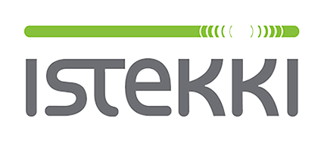






Some of our customers
Our customers come from both the private and public sector. We have worked with many of the top300 companies in Finland from all industries. We are also a strong player in the public sector, building our digital society.
We are used to working with the most demanding customers, such as the Government Security Network. Other focus areas include product development and R&D.

Slide 36

Customer success stories: Ministry of Economic Affairs and Employment
ELY-Centers are responsible for e.g. labour force, competence and cultural activities.
We have been a major partner in transforming customer's processes to modern digital environments and automating them.
The purpose of the TE-digi project was to build completely new digital services for employment and economic administration authorities, for the use of individual and corporate customers as well as experts.
We have had more than 70 professionals working for the customer for several years.
"twoday has been a very flexible and good partner. The agile working methods and direct contact with the experts have ensured that things are moving forward and we have always received help when needed."
Ville Rötkö
Product owner,
ELY-keskus

Slide 37

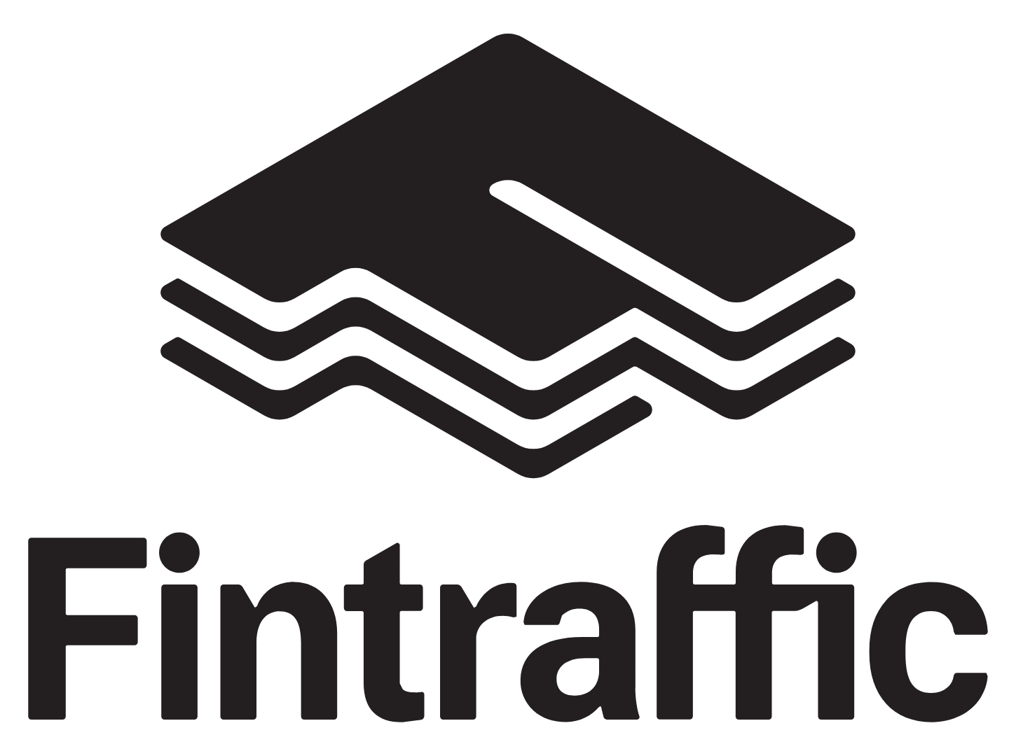
Customer success stories:
Fintraffic
Fintraffic controls traffic on land, at sea and in the air and helps people and goods arrive safe and smoothly. Intelligent traffic control services, digital services and up-to-date traffic information are at the core of Fintraffic’s work.
Together with Fintraffic, we developed the new Fintraffic Mobile application, which aims to make traffic even smoother and safer.
The application provides real-time information on Finnish roads and rail traffic, as well as a feedback channel. Location-based push notifications inform the user immediately when something abnormal happens nearby on roads or a preferred rail route.
"The work has been very expert and twoday has been a good partner. Even though sometimes it’s about quite complicated things and, for example, traffic data and its processing can be new thing for developers too, it’s been handled well and got a great application done."
Antti Haarala
Head of Digital,
Fintraffic

Slide 38

Customer success stories:
Istekki Oy
Istekki Oy is an in-house company providing services for 16 wellbeing services counties serving more than 4 million citizens.
We provide professional software development teams, tools and processes to enable wellbeing services counties digital transformation through web and mobile e-Services. End users – any of us – can now use health services through a single service point for each county.
Currently, we have more than 40 software developers working for these services in several teams.
“twoday has been an excellent partner in our customers' digital transformation processes.”
Sami Niskanen
Business Manager,
Istekki Oy

Slide 39

Data & analytics
Drive your business with data strategically

Slide 40


How we can help
We are a one-stop shop for advanced data and analytics solutions.
We help our customers see the potential of data in driving their business and operations and implement solutions ranging from data platforms to management dashboards and financial planning
to advanced data driven optimisation algorithms.
Typical customer challenges:
Seeing where business is succeeding and manage using accurate and up-to-date data
Forecasting and planning based on tangible business fundamentals
Storing and combining data from various sources for all use cases – also in real time
Using AI/ML/optimisation to enhance human decision making
Our competencies
  Dashboard design & development
  Data platforms & data warehousing
  Business planning & budgeting solutions
  Data science & optimisation
  IoT data solutions
  Financial consolidation & profitability management solutions

Slide 41






Data & Analytics in twoday Finland
Data Platform
Reporting
Planning
Data Science
Custom apps
We can deliver
world-class data
platforms of any scale
No business problem
is too complex for us
Budgets, estimates and simulation models done right
Optimisation, AI, ML, algorithms that discover the unseen
Tailor-made solutions to our customer’s critical data process
Consulting
Solutions
IoT
Maintenance Services
Insightful understanding of our customers data and their businesses
Profitability calculation,
Data Vault modelling and automation solutions to any business need
High velocity data, sensor data, true big data - we have solutions to digest and analyse it
We will monitor, solve issues and deliver all support services for our solutions

Slide 42




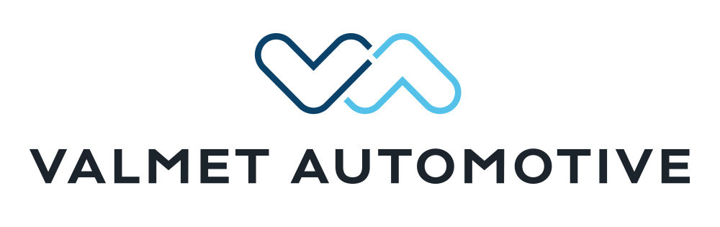

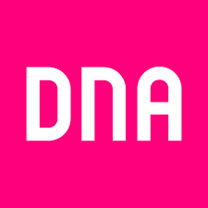






Some of our customers
We have ~200 customers in Finland in the Data & Analytics area. Most of our customers are among Finland’s largest companies, but we work also with larger SMEs and the public sector.

Slide 43

Customer success stories:
Valmet
We have been working with Valmet on many different data & analytics related topics for many years. The depth and breadth of our co-operation helps us deliver solutions with tangible business benefits. Below are some of our co-operation areas:
Business planning solution for 2 000 end users
We helped Valmet design and implement a new driver based financial planning system. The solution was to create a flexible and modern system based on the Anaplan platform to enable accurate business planning.
Enterprise-wide data platform and reporting
We have been Valmet’s partner on enterprise level Azure data platform development for years, enabling the use of data in decision making in all parts of the organisation.
“twoday’s consultants have been very skilled and our work dynamic has been working well since the beginning. Transparency throughout the project has been great and I value that highly.”
Petteri Peltomäki,
Project Manager, Business Reporting Development, Valmet

Slide 44


Customer success stories:
Savox Communications
We help Savox Communications on their journey towards data driven decision making and management.
Management reporting and supporting data warehouse
While we speak of data as a key asset in business, many organisations find that they don’t yet have sufficient possibilities to use data in their day-to-day management. This is what we came in to enable at Savox.
Over several incremental projects we built an Azure based data warehouse and a set of Power BI dashboards covering different aspects of management including sales, supply chain, production and finance. The dashboards were designed jointly with Savox, ensuring the best possible value and fit with their management practices.
“Our co-operation truly brings ideas and builds on experience accumulated in other projects. It has been a significant benefit and exceeded expectations.”
Terhi Rantala
COO,
Savox Communications

Slide 45

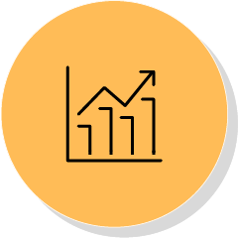
Process development, automation, AI & optimisation
Enable smooth, automated & optimised processes

Slide 46

How we can help
Process Analysis: Analyse processes and lead your business with business process management.
BPMS: Orchestrate, automate and control long end to end processes with complex business logic.
RPA: Automate simple and repetitive manual tasks with large volume, such as data entry, invoice processing, and customer service inquiries.
AI: Improving customer experience through chatbots, personalised recommendations, and predictive maintenance in manufacturing.
Optimisation services: Optimising supply chain operations, logistics, and workforce scheduling to reduce costs and increase efficiency.
RPA & AI: Enhancing fraud detection and prevention in financial services, insurance, and healthcare industries.
We provide process development, automation, RPA, orchestration, AI and optimisation services to help companies automate and streamline their processes, improve customer experience and boost efficiency. We help businesses stay ahead of the competition by automating long and complex end-to-end processes with cutting-edge technology.
Our competencies
  Process analysis BPM
  Process automation BPMS
  RPA & AI & machine learning
  Resource planning & process optimisation

Slide 47
Process development & RPA
Automation, AI and optimisation
We offer a toolbox for process development and automation, focusing on the business needs of our customers.
Using business process management methodology, we
analyse, develop and automate our customers’ processes
support them in continuous improvement of their operative processes
offer enhanced visibility and control
We automate long end to end processes with BPMS suites. Manual repetitive tasks can be automated with RPA, freeing up time for employees to focus on more meaningful work.
AI capabilities allow for advanced data processing and analysis, enabling businesses to make informed decisions and improve customer experience.
Integration services ensure seamless communication between different systems, streamlining workflows and improving efficiency.

Slide 48








Some of our customers
We have successfully worked with customers in private, public, and third sectors. We have streamlined processes in banking and insurance as well as in healthcare. We have a proven track record of working with fast growing new businesses and already established large scale companies.

Slide 49

Customer success stories:
HUS – Billing automation
HUS is a major healthcare provider who had a need to automate their billing system. ​
​
The goal of the project was to enhance the modularity, usability and reliability of the system. Project included process planning, process analysis, process execution and definition of the process from the point of view of the chosen BPM methodology.​
​
Our specialists have analysed the system logic behindthe current billing process and based on that they have built the new system functions. ​Process
analysis and utilizing the rule engine Rule based
automation was executed with IBM ODM technology.

Slide 50

Customer success stories:
2M-IT – Process automation
In a large project for 2M-IT we did a RPA automation solution to handle tasks in a desktop application user interface.
The process included a wide variety of possible outcomes ruled by source data available in the system, with a notable amount of exception handling. Automation reports run results to the client.
Our specialists took part in process planning, defining the technical execution, development, testing and implementing the solution to the production environment.

Slide 51
AI & automation: twoday AI Agent
Automation, AI and optimisation
twoday AI Agent is a cutting-edge AI application that serves as your company's personal superintelligence.
twoday AI Agent
Leverages the power of the GPT language model
Enhances data processing efficiency and accelerates business operations
Automates internal and external service processes
Can easily be trained to learn all of your essential business data, no matter the source
Can process data quickly without any limits
Enables superior customer service
Saves you time, money and effort by gathering your company's data in one place and automating outdated and unmanageable processes
Tailored to your business: Unlike ChatGPT, AI Agent provides complete information security and always delivers accurate and reliable information that is tailored for your company.
Secure: Can be securely trained to learn any information for any purpose, from any internal or external sources. The service is fully compliant with GDPR and other data protection regulations, ensuring your company's data is always protected and handled in accordance with legal requirements.
Countless use cases & easy to integrate: Can be connected to any pre-existing channel and used for countless purposes, such as customer service automation, support for specialists or HR & financial processes.
Ready to use: The service comes with an operating environment ready at your service, so you can start using it right away, not after months or years of building.

Slide 52
Optimisation
Automation, AI and optimisation
We focus on helping our clients increase their productivity with state-of-the-art optimisation solutions. Typical application areas are logistics, workforce planning and production planning.
Why we are strong optimisation experts:
Top-level optimisation experts with combined research and industry background
IPR portfolio with high-performance algorithms
Strong partnership with the world-leading solver provider Gurobi
Our data scientists are fluent in many languages such as Python, C#, R, and .NET. That said, optimisation solutions are technology-agnostic and can be utilised in all modern IT environments (Azure, Google Cloud, AWS). Some solutions require high data-security and can be delivered from our domestic data centers or on-prem.

Slide 53





Some of our customers
Our customised solutions improve productivity at many large enterprises. A more efficient way of operating can also be the competitive advantage for a mid-sized company, where we can provide them a way of staying ahead of the market.
Optimisation use cases are abundant in sectors such as supply chain and manufacturing, logistics, healthcare, retail and transportation. Most of our clients are from these areas both from the private and public sectors.

Slide 54

Customer success stories:
Taksi Helsinki
Taksi Helsinki provides publicly subsidised taxi rides for customers. These trips can be merged such that two or more customers share the same taxi.
The purpose of merging trips is to:
improve customer service during peak hours
decrease environmental impact
save public funds
The solution has exceeded expectations with over
250 000 kms of reduced driving and 0.5M€ lower
public expenditure in one region alone.
“We wanted to have the most efficient solution for combining the rides, and that’s why we chose twoday. We have been very satisfied with the cooperation.”
Teemu Niemelä
Service Manager
Taksi Helsinki

Slide 55

Customer success stories:
ISKU
ISKU offers a wide range of furniture products and interior design solutions for businesses and consumers. The competition in B2B is fierce and they wanted to support their salespersons with the latest technology.
We delivered an AI model, which utilises information about the sales history and client background to suggest the best price for a deal. The tool was well-adopted by the salesforce and has been a valuable addition to the process.
“From the salesperson's point of view, the pricing tool is a great addition. With this, we get factual information to support pricing.”
Anssi Turpeinen
Key Account Manager
ISKU

Slide 56


eGovernment
Digitalise public sector services successfully

Slide 57

How we can help
We offer customised digital solutions that streamline and automate organisations' business processes, improving their efficiency and customer experience. With our expertise and state-of-the-art technology, we help organisations achieve their business goals and make their services more accessible.
You can get everything from us for case management as well as document management and archiving. All of our solutions are SÄHKE2 certified and work seamlessly together as separate services.
Our solutions
  Case & document management
  Contract management
  Meeting management
  E-services
  Digital archive: X-Archive
  twoday eBusiness Suite

Slide 58
twoday eBusiness Suite
Features for a wide scale of needs, including:
eBusiness, case management, electronic signature, electronic archive and customer experience measurement
Flexible and easy to use:
Suitable for both the public and private sectors
Ready-made components and tools make building and customising service processes and channels easy. Process descriptions can be created without programming skills.
Low-code platform makes developing processes easy
Secure:
Our products are SÄHKE2 certified and meet strict quality and security requirements.
Easy to scale & integrate:
Solutions are scalable and easy to integrate to other systems
twoday eBusiness Suite is a user-friendly and flexible software platform that enables the automation and digitisation of service processes. It offers various subsystems, process management, service management tools, and integrations.
We have extensive expertise and development capacity, enabling us to respond quickly and efficiently to our customers' changing needs.

Slide 59












Some of our customers
Our solutions are used by a wide range of public administration organisations. Customers include cities, state administration organisations, and third sector actors.

Slide 60


Customer success stories:
HUS
HUS Ohjepankki
A browser-based user interface customised to meet the needs of HUS provides tools for managing the entire life cycle of guidelines, from creation to review, approval, and archiving. In the HUS guideline bank, users can find up-to-date treatment and patient guidelines from thousands of guidelines available.
"The guideline bank improves patient safety as well as healthcare's cost-effectiveness, reliability and process management."
Janica Raaska
Project Manager,
HUS

Slide 61


Customer success stories:
City of Helsinki
Helsinki City Feedback and Contact System improves service transparency, streamlines contact handling, provides flexible processing for various contact types, and utilises contact data for service and operation development. The system offers easy reporting, tracking, and publishing of feedback, complaints, and maintenance issues, with automated classification, processing, and routing to relevant parties, and a knowledge base to support contact handling. The system's data is also analysed to improve service quality.
Helsinki City e-archive system is meant for long-term storage of digital data. The system supports data integrity, authenticity, and immutability, and ensures compliance with applicable laws and regulations. The goal of the system is to unify the long-term storage of data across Helsinki City's departments and services, and enable easy access for external parties while maintaining data security.
"The new feedback and contact system will help make Helsinki even more beautiful and functional."

Slide 62

We create a better tomorrow through technology

